Slide 1
Putting it all Together: Technical Debt!*
Damian A. Tamburri, Ph.D.
Many slides courtesy of Prof. Dr. Ir. Philippe Kruchten

Slide 2


Slide 3
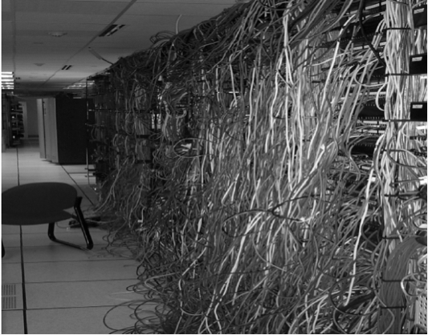
What is technical debt?
Notes:
What is technical debt
Work you put off
Initial compromises that come home to roast
That missing documentation
Tools we used
Static Analysis
Issue is that we don’t see over time

Slide 4
Technical Debt
Whenever code meets functional requirements but is suboptimal or “quick and dirty.” E.g.:
“smelly” code
inefficient algorithms
sloppy design
Might be fixed at code-review, might generate TODOs or new issues in the issue tracker
Understanding and communicating about technical debt is critical in industry

Slide 5
Technical Debt means you get less done as a code base ages
Sprint 1 – new work
Sprint 2 – new work
Debt
Sprint 3 – new work
Debt
Sprint 4 – new work
Debt
Sprint 5 – new work
Debt
Notes:
It builds up over time
It is not as if we don’t have tools to measure it
However, unless we enforce a zero level in the Microsoft space it has been hard to manage

Slide 6
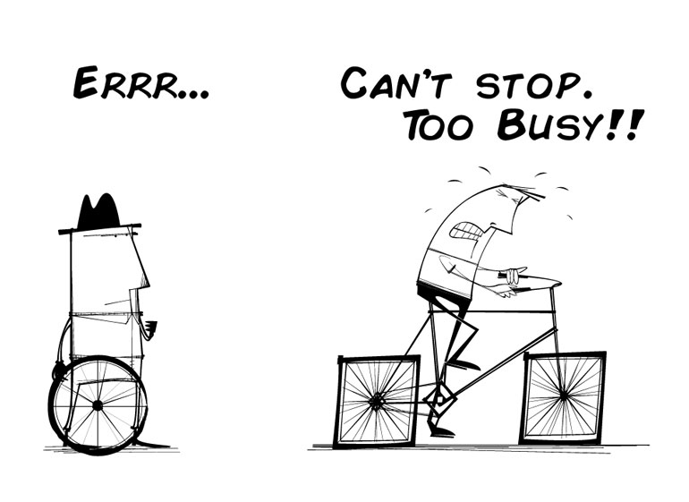
Technical Debt

Slide 7
What is debt (in a financial sense)?
  Do you have any financial debts?
  Is “debt” (always? ever?) a bad thing?
  Is “debt” (always? ever?) a good thing?

Slide 8
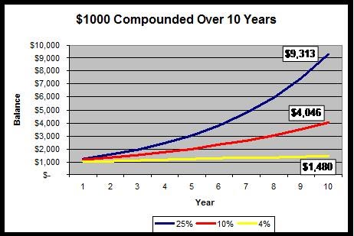
Compounding

Slide 9

What is the idea of “technical debt”?
Sources/Kinds of Technical Debt
  Unfit (bad) design
  Defects
  Insufficient test coverage
  Excessive manual testing
  Poor integration and release management
  Lack of platform experience
Briefly, define each kind

Slide 10
Reasons/Causes of Technical Debt
How do the following types differ?
  Naive technical debt
  Unavoidable technical debt
  Strategic/Deliberate technical debt
Give an example of each type

Slide 11
Debt Analogy
Is debt always bad?
Real life is about shipping code that works
“Shipping first time code is like going into debt. A little debt speeds development so long as it is paid back promptly with a rewrite – the danger occurs when the debt is not repaid. Every minute spent on not-quite-right code counts as interest on that debt.” – Ward Cunningham
Can you afford to do it without debt?
Can you afford the interest?
Can you keep the debt and interest manageable?

Slide 12
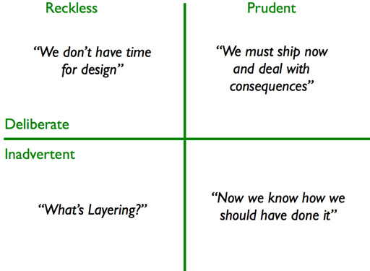
Classes of debt

Slide 13
Strategic, Intentional Debt
Cunningham’s original definition only considered intentional debt - debt can be “planned debt” or it can be “happened-upon” debt, both can be strategic
“Ship now and deal with the consequences later”
Examples of intentional or strategic debt:
Non-modular design
Purposefully too-simple/too-complex implementation
Performance indifference
Lack of generality or extensibility
Lack of scalability

Slide 14
Non-Strategic, Unintentional Debt
Debt also accumulates unintentionally, no development process is perfect
Examples of unintentional or non-strategic debt:
Memory leaks
Insufficient test coverage
Unintentionally complex implementation
Rigid/brittle architecture
Performance or scalability bottlenecks
Sloppy or difficult to maintain code

Slide 15
Consequences of Debt
Too much debt => too much time paying interest
Unpredictability in software planning stage, increased risk of investment
Slows down future work
More bugs, more expensive to fix them
Frustrated, unhappy developers

Slide 16
Debt Tradeoff
Zero-Debt Product
Technical
Debt
Working Features
Indebted Product
Rapid Progress
Debt Value Inflection
- Too much time is spent paying
interest and development slows
to a crawl
Over-Engineered
Time, Size, Lines-of-Code, etc.

Slide 17
Communicating Debt
Writing good code isn’t just a matter of professionalism or craftsmanship:
There is no moral or intellectual imperative to produce good code
Every bit of debt incurred today reduces your future ability to produce working features
Technical debt has a real cost- not “interest” as we have described- your future productivity… your manager will literally pay for it later
Likewise, writing good code or refactoring costs more now, but results in savings later

Slide 18
Debt Avoidance
Non-strategic debt is not helpful by definition
Avoid non-strategic debt:
Use good engineering practices – test-driven development, good architectural patterns, etc.
  If you’re not actively working to make your system simpler and with less cruft, it’s getting worse
Strong “definition of done”- user requirements are the baseline, how much debt are you willing to accept each sprint or for each feature?
Refactoring- reducing debt without changing behavior

Slide 19
Debt Management
Known debt is everything recorded in an issue tracker or product backlog
Devoting effort to get rid of that debt is a quantifiable business decision
Doesn’t always make sense to work on debt: e.g. prototypes, end-of-life software, small projects
Good practice to pay down debt a little at a time versus ignoring it and making a “balloon payment”
When you find debt- use the “boy scout principle”: clean up what you can, log the rest as known debt, leave the camp cleaner than you found it

Slide 20
Accumulation of
Technical Debt
False “acceleration”
Deadline pressure
Decreased verification
Cumulative debt effects (decreasing velocity)

Slide 21
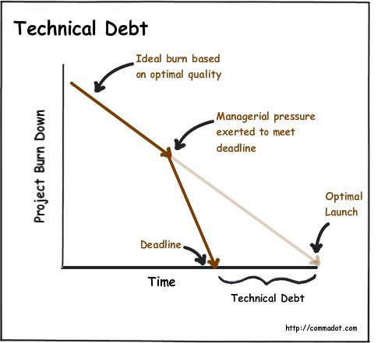
Accumulation of
Technical Debt due to deadline pressure
Debt
time saved to product release

Slide 22
Consequences of Technical Debt
Rising development & support costs
Increased delivery time
Significant # of defects
Decreased customer satisfaction
Unpredictable tipping point
Universal frustration
(morale)
Product atrophy
(Defect Sprints)
Under-performance
Decreased predictability

Slide 23
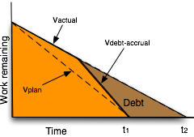
Paying debt from “false acceleration”
Additional time needed to
service previous debt

Slide 24
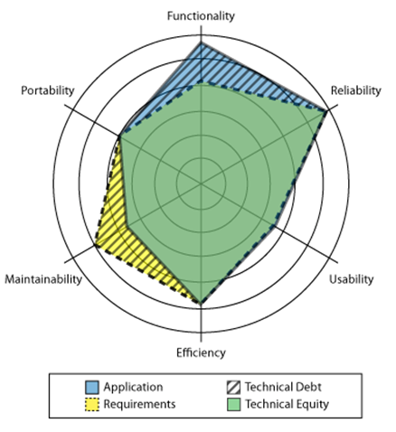
Technical debt is a gap

Slide 25
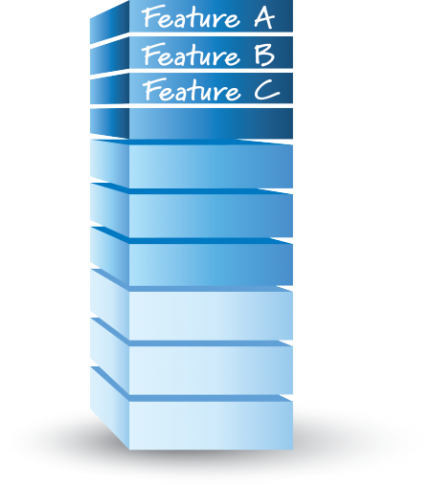
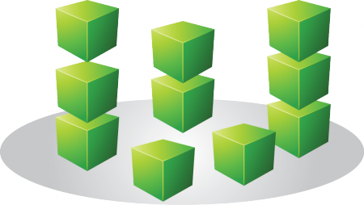
Making Technical Debt Visible
Technical Debt Backlog
(Defect PBIs,
Internal Improvement PBIs)
Feature Backlog

Slide 26
Managing Technical Debt
Managing debt accrual | Making debt visible | Servicing the debt
Good technical practices | Visibility at the business level (balance sheet) | Deciding whether to repay
Strong “done” definition | Visibility at the technical level (defects, PBIs, cards) | Repay when found, incrementally, high-interest first
Understanding of debt economics (delay vs repayment costs) | Technical Debt Items in Product Backlog | Repay while producing value (avoid balloon payments)

Slide 27
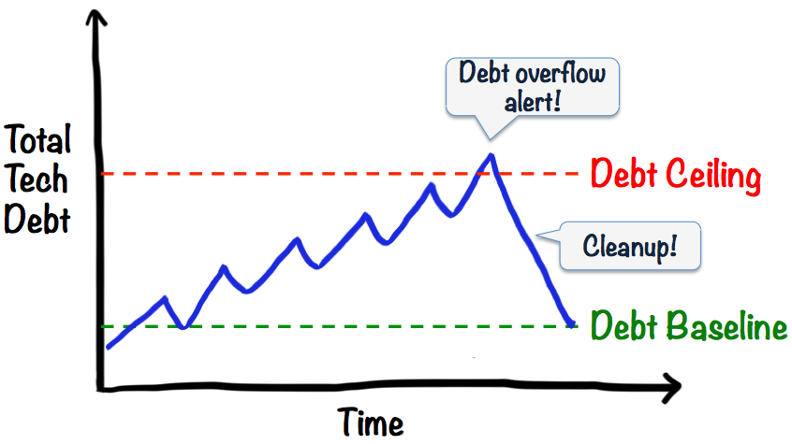
Servicing Technical Debt

Slide 28
Properties of debt
Visibility. Significant problems arise when debt is not visible. In many cases, it is (or was) known to some people but it is not visible enough to others who eventually have to pay for it.
Value. In its financial use, debt when managed correctly is a device to create value
Present value. In addition to the overall potential system value enabled by technical debt, the present value of the costs incurred as a result of the debt, including the time-to impact and uncertainty of impact, must be mapped to the overall cost-benefit analysis.

Slide 29
Properties of debt - 2
Debt accretion. Debt does not necessarily combine additively, but super-additively in the sense that taking on too much debt leads a system into a bad, perhaps irreparable state
Environment. In software engineering projects, debt is relative to a given or assumed environment.
Origin of debt. It is important to distinguish sharply between strategic debt, taken on for some advantage, and unintentional debt, that is taken on either through poor practices or simply because the environment changed in a way that created a mismatch that reduces system value.

Slide 30
Properties of debt - 3
Impact of debt. The locality (or lack thereof) of debt is important: are the elements that need to be changed to repay a debt localized or widely scattered?

Slide 31
Assessing Technical Debt
Complexity
Code Duplication
Documentation Debt
Testing Debt
Architectural Debt

Slide 32
Research issues
Refactoring
Architectural issues
Identifying dominant sources of debt
Measurement issues
Non-functional artifacts
Monitoring
Process issues

Slide 33
Architecture technical debt
Dependencies that exist in the current architecture but that should not exist are technical debt.
reference architecture
meta-architecture
enterprise architecture

Slide 34
Entropy reduction
Use code tags.
Establish a rhythm.
Time-box the ER activity
Don’t ship the result
Choose your language carefully
Use ER to reinforce other values you deem important
Don’t commit unless you can deliver.

Slide 35
Why no-one repays technical debt
Business people don’t see technical debt.
Perceived low ROI.
Developers don’t like repaying technical debts.
Development processes don’t focus on it.

Slide 36
Managing Technical Debt…Where are we?
Tools & automations
Org. Culture
Social Debt?

Slide 37
What tools do we have in Sw.eng. land?
Compiler Errors/Warnings
FXCop/Code Analysis
StyleCop
Unit Test Coverage
Numerous other tools….
But they are snapshots in time, we need a better dashboard

Slide 38
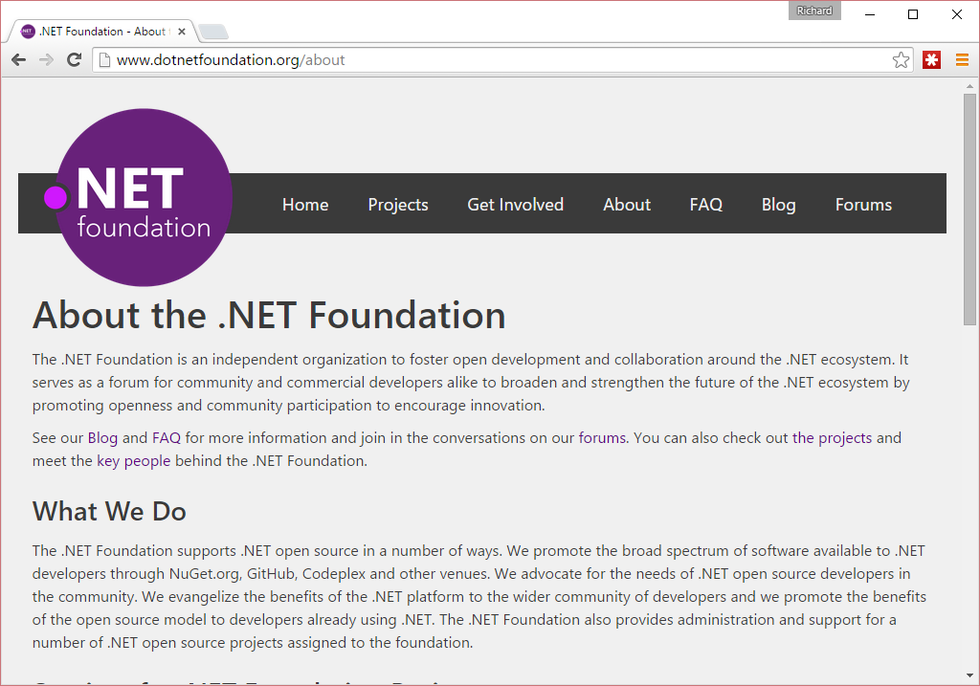
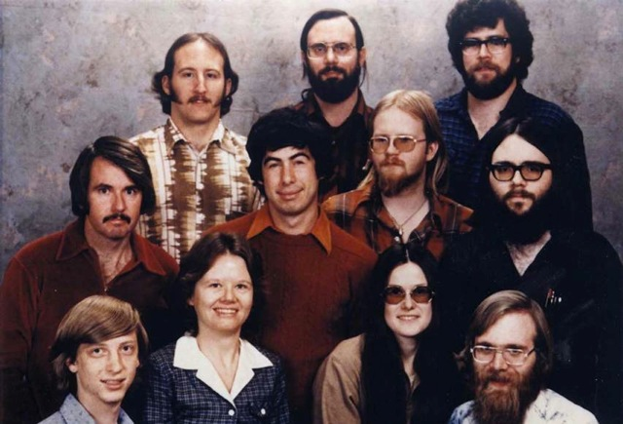
This is not your grandfather’s Microsoft
Microsoft staff in 1978
Notes:
Not your old Microsoft
Pick a market leader
Work with the team
Leverage what Roslyn can do
Provide a viable alternative to StyleCop/FxCop and more

Slide 39
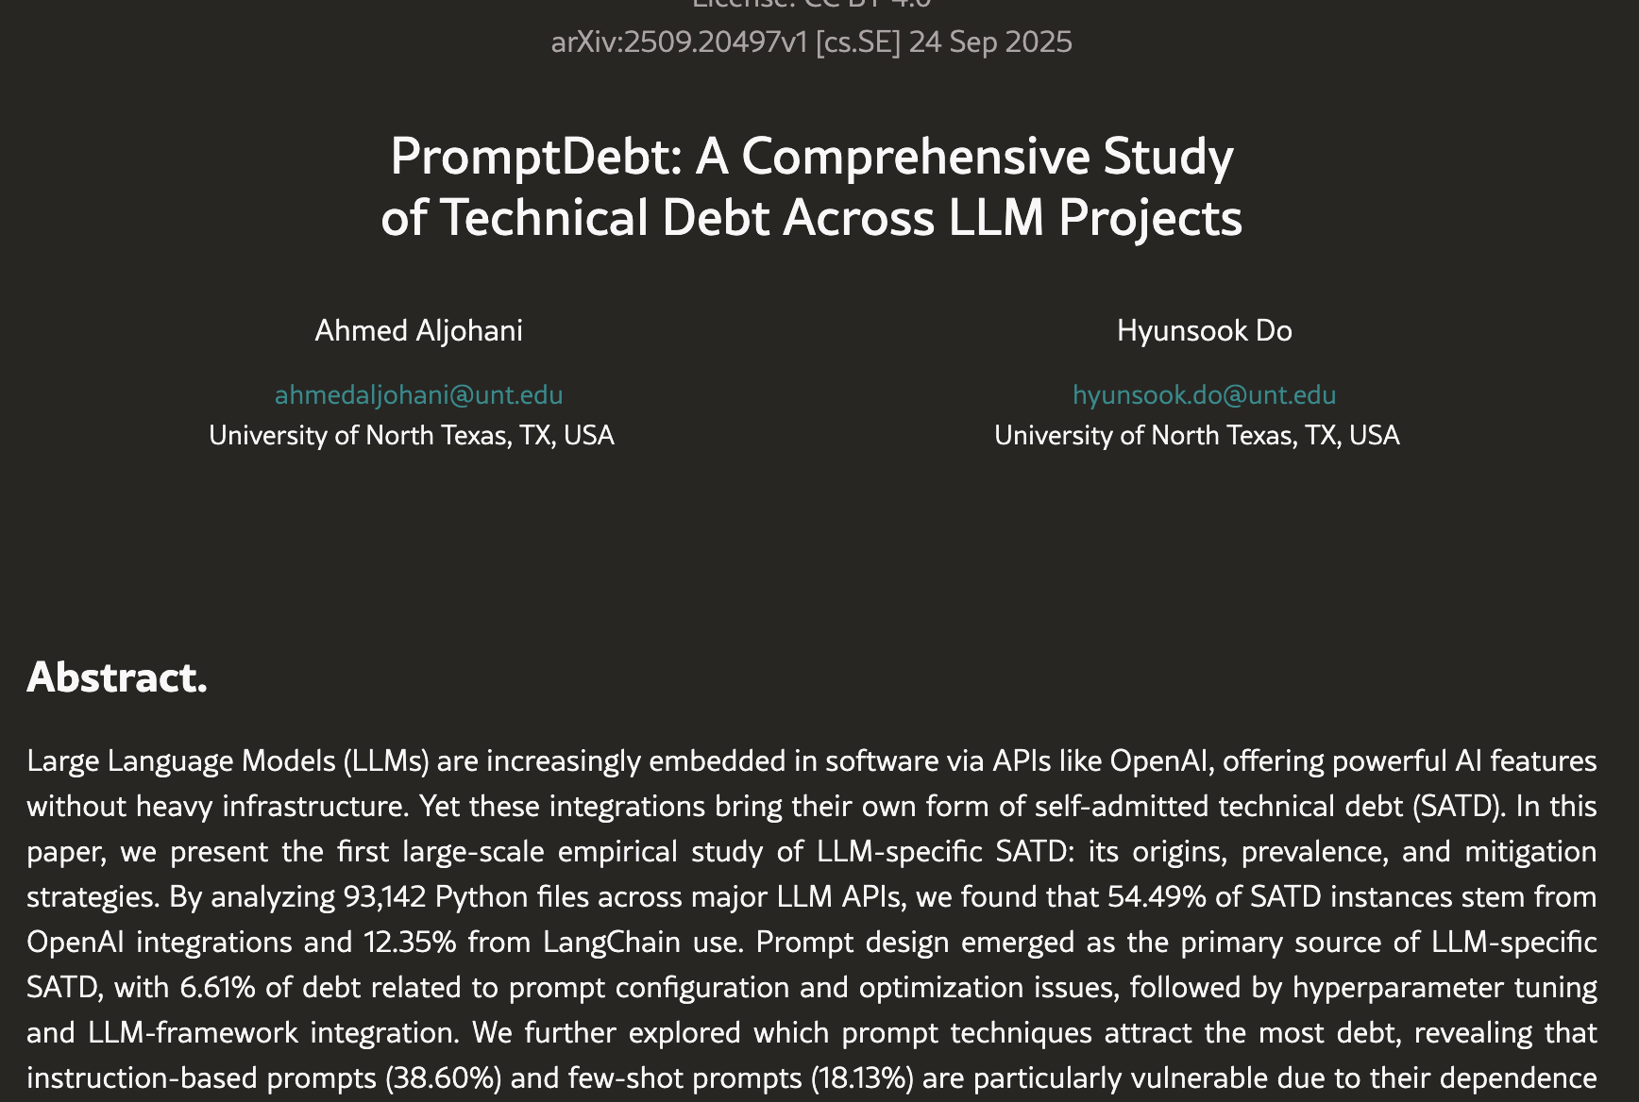
LLM Bit…

Slide 40


Slide 41
Addressing Tech. Debt

Slide 42


Slide 43
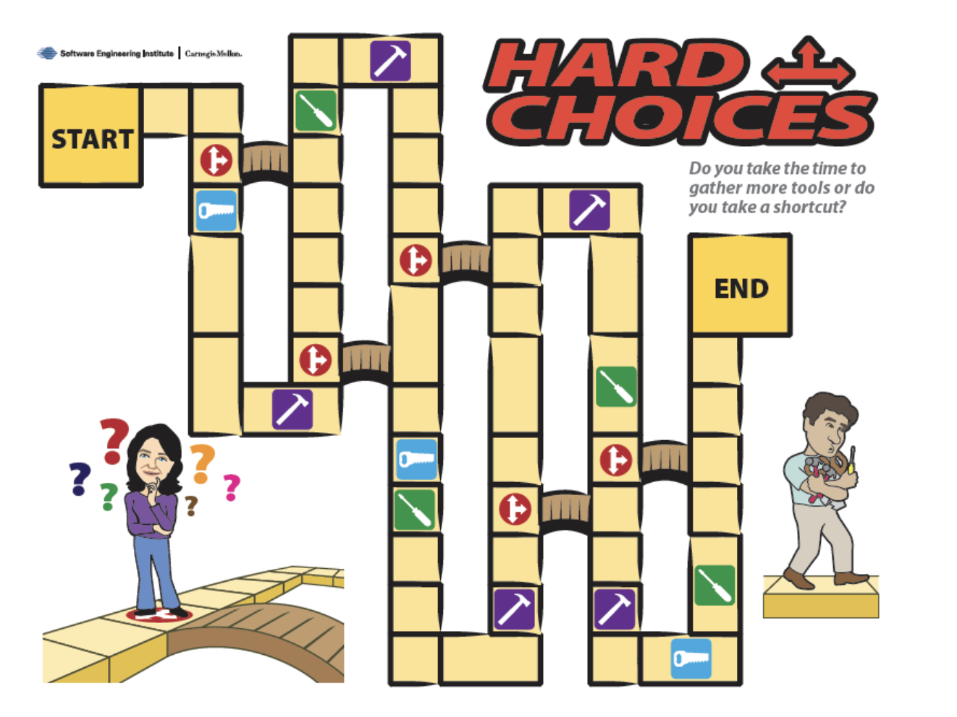

Slide 44


Slide 45
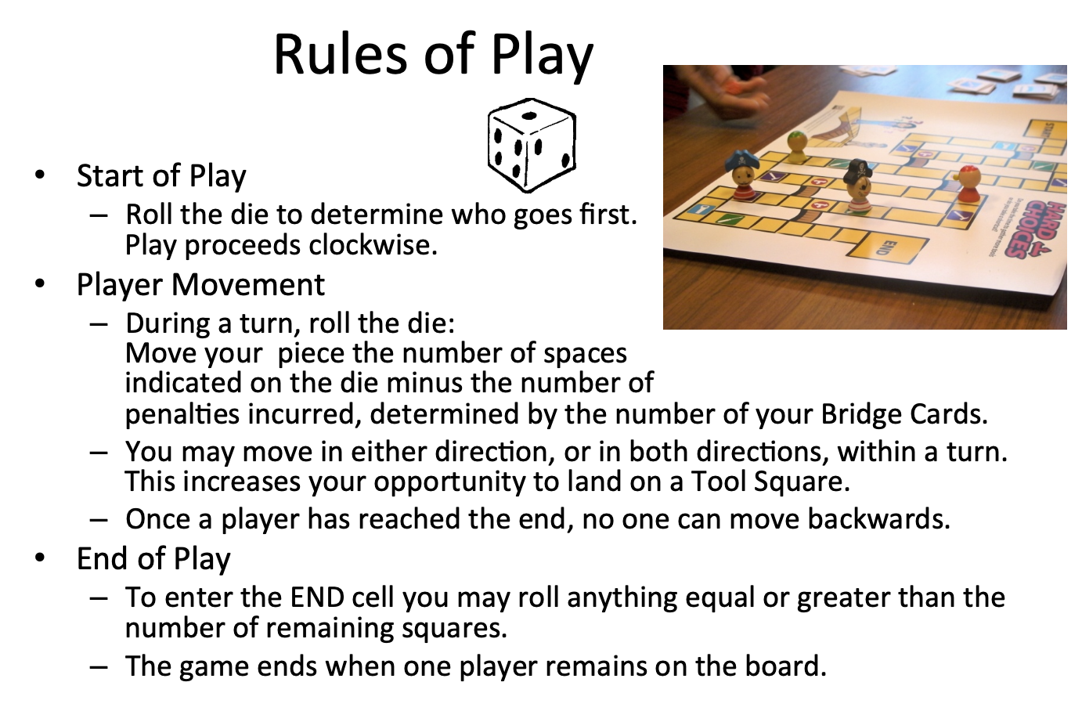

Slide 46
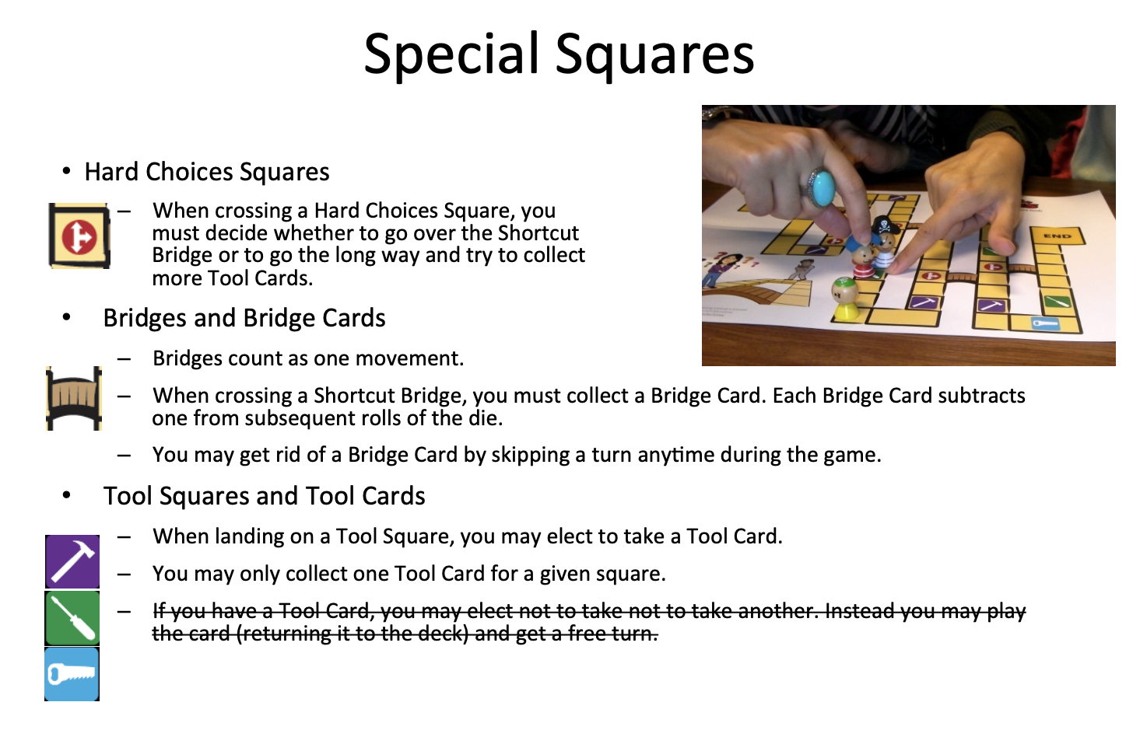

Slide 47
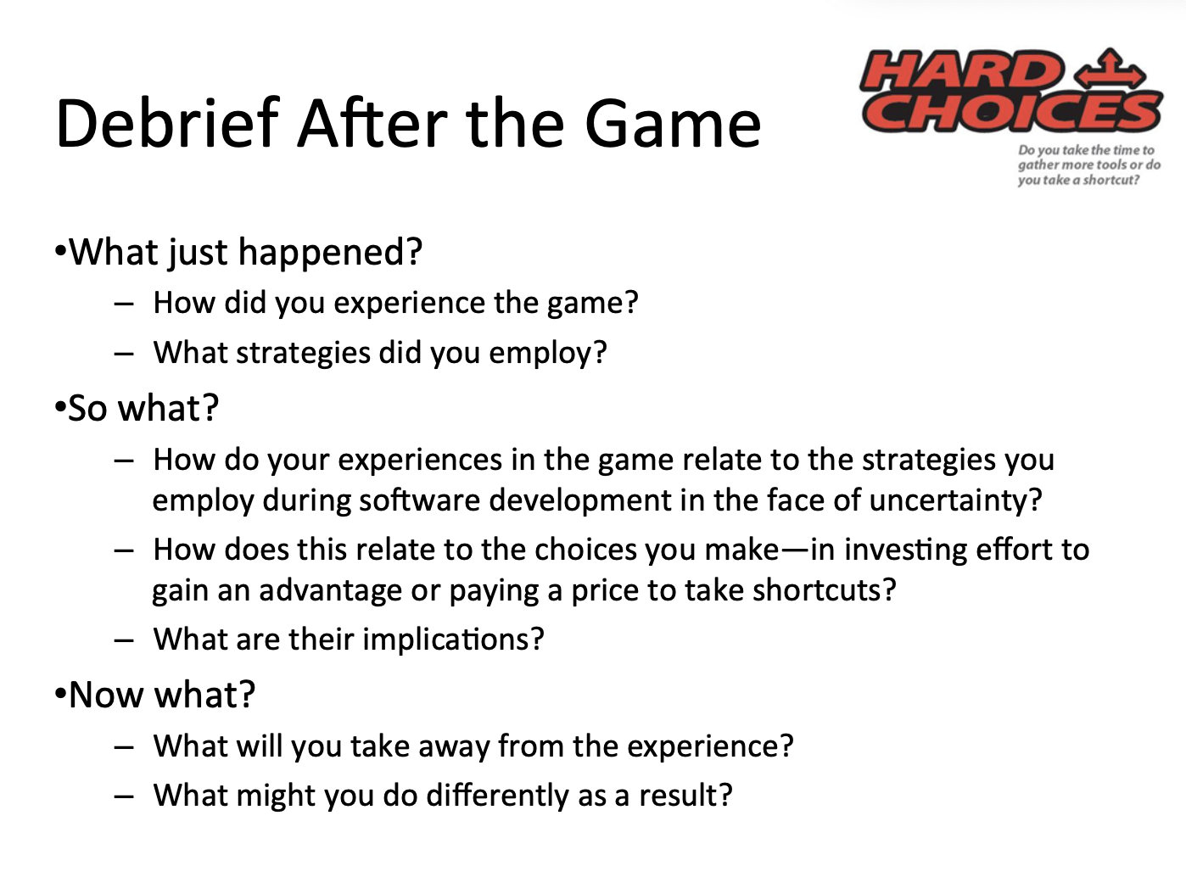

Slide 48
Insights from the trenches…

Slide 49
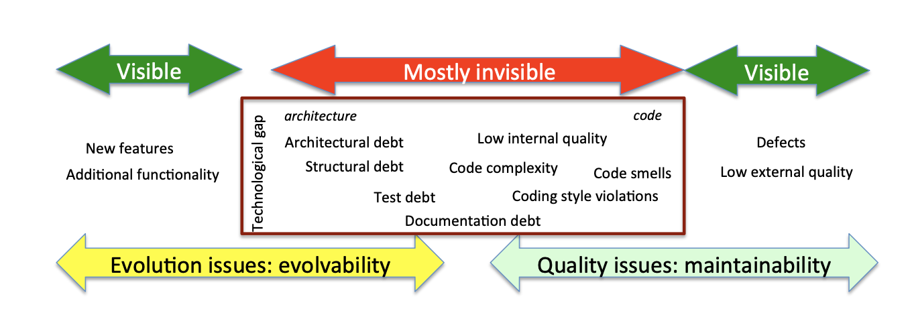

Slide 50
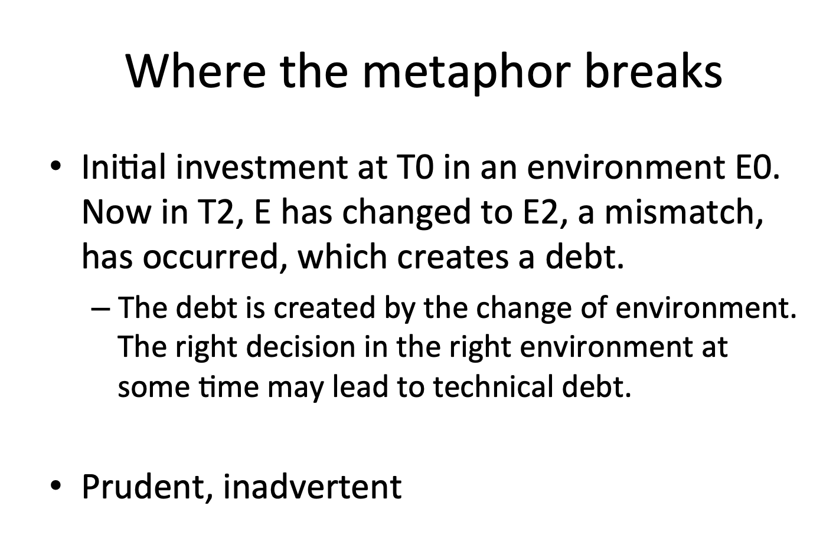

Slide 51
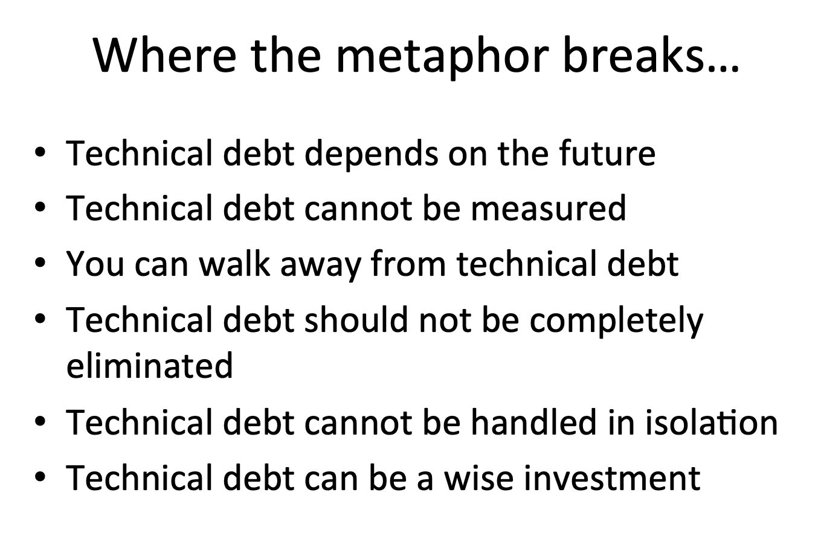

Slide 52
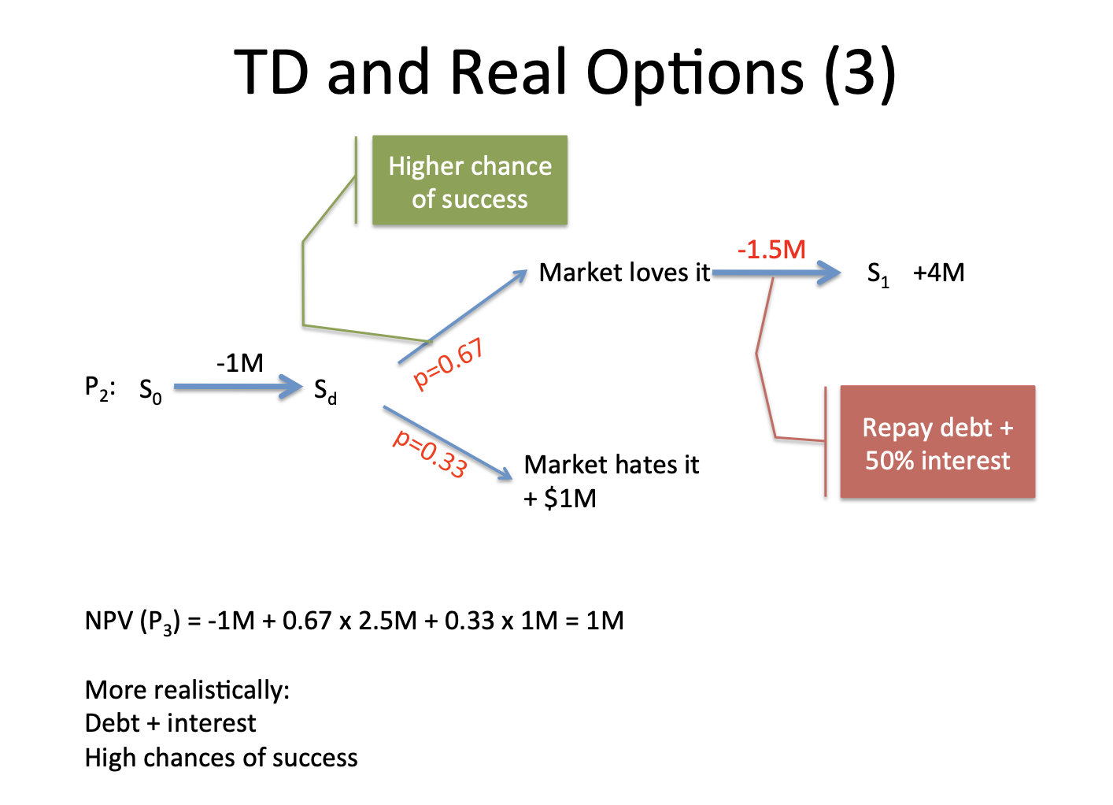

Slide 53
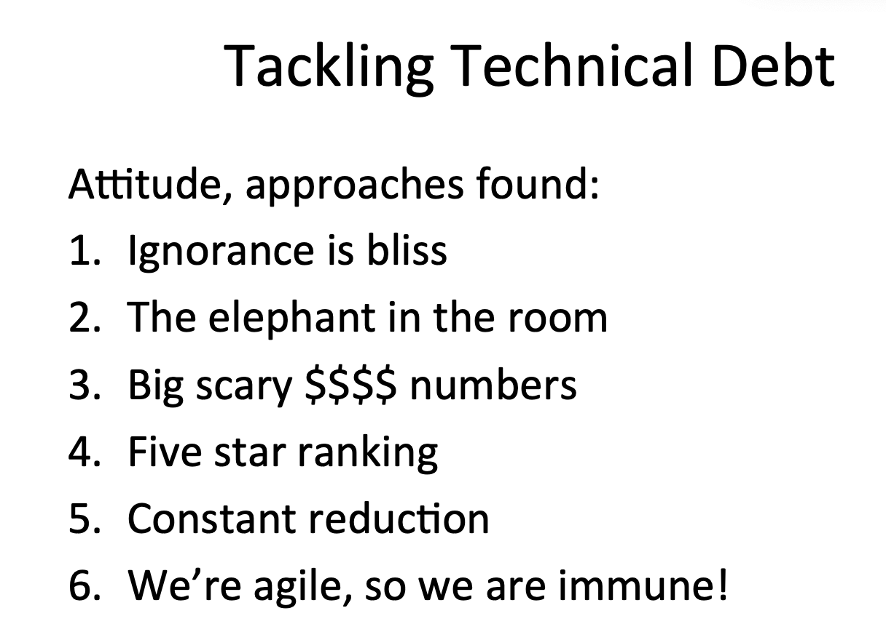

Slide 54
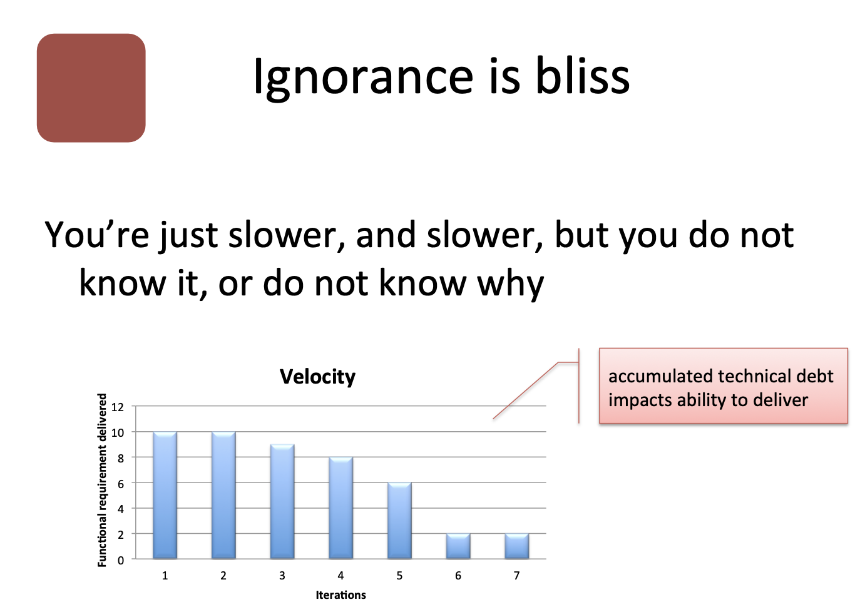

Slide 55
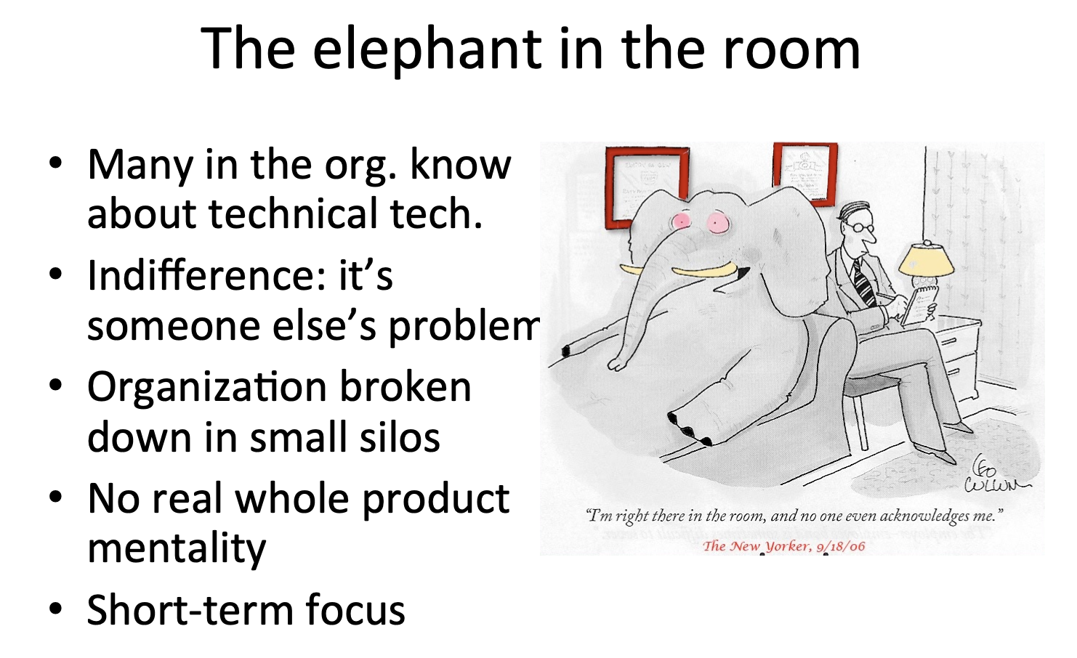

Slide 56
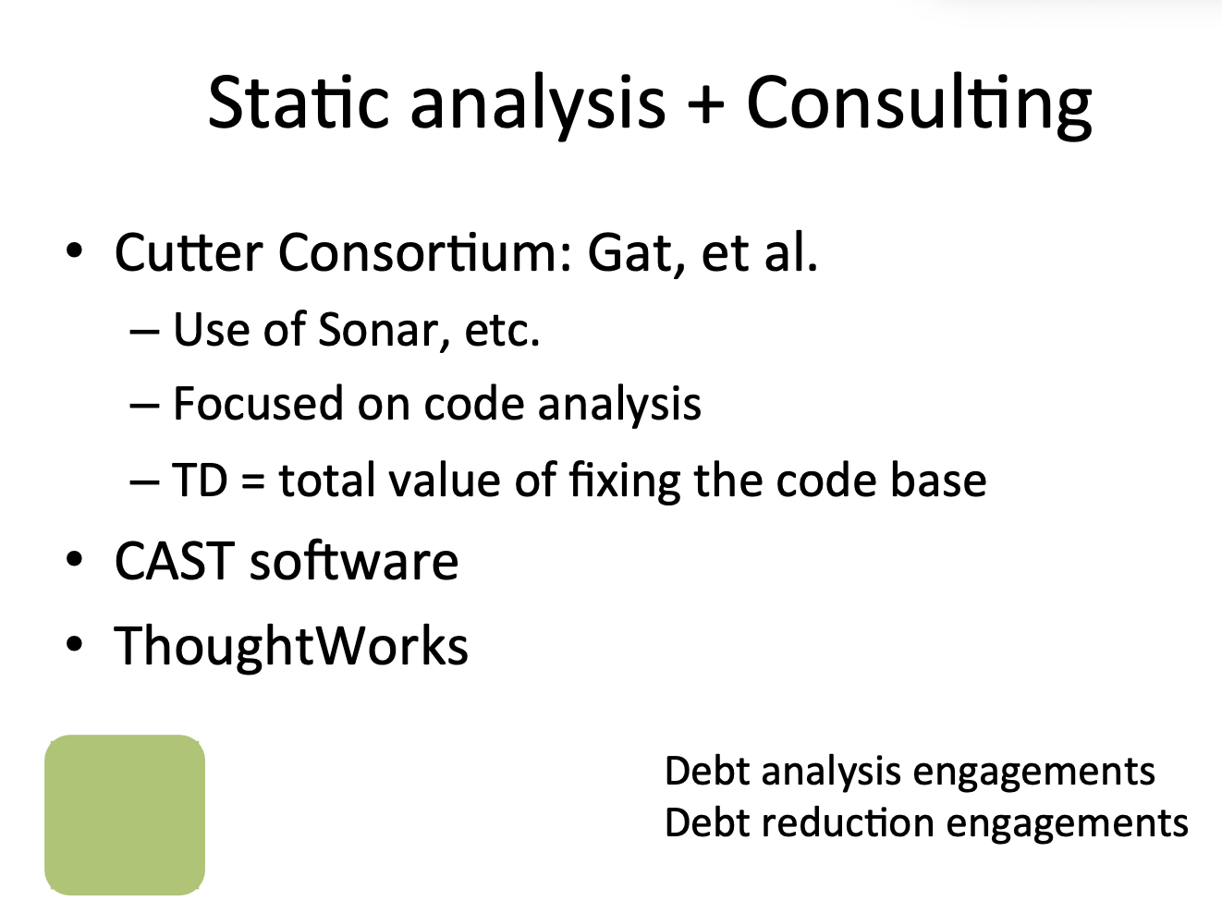

Slide 57
So what do I see in SonarQube?
Dashboards
  Tables and Charts
  Trends over time
  Base-lines based on version
Technical Debt time estimates
Quality Ratings
Quality Gates

Slide 58
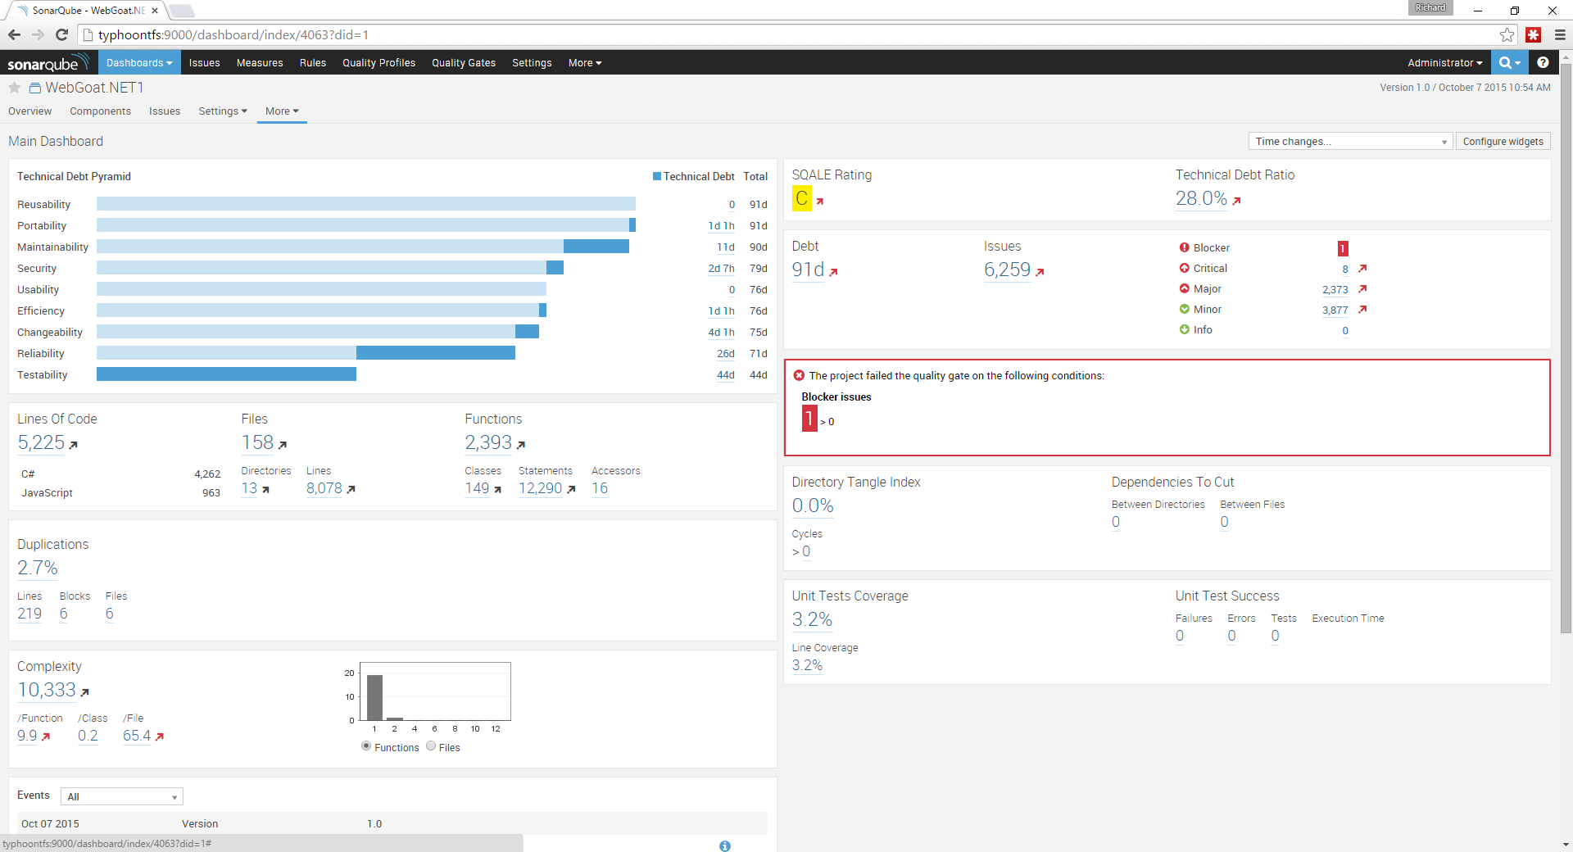

Slide 59
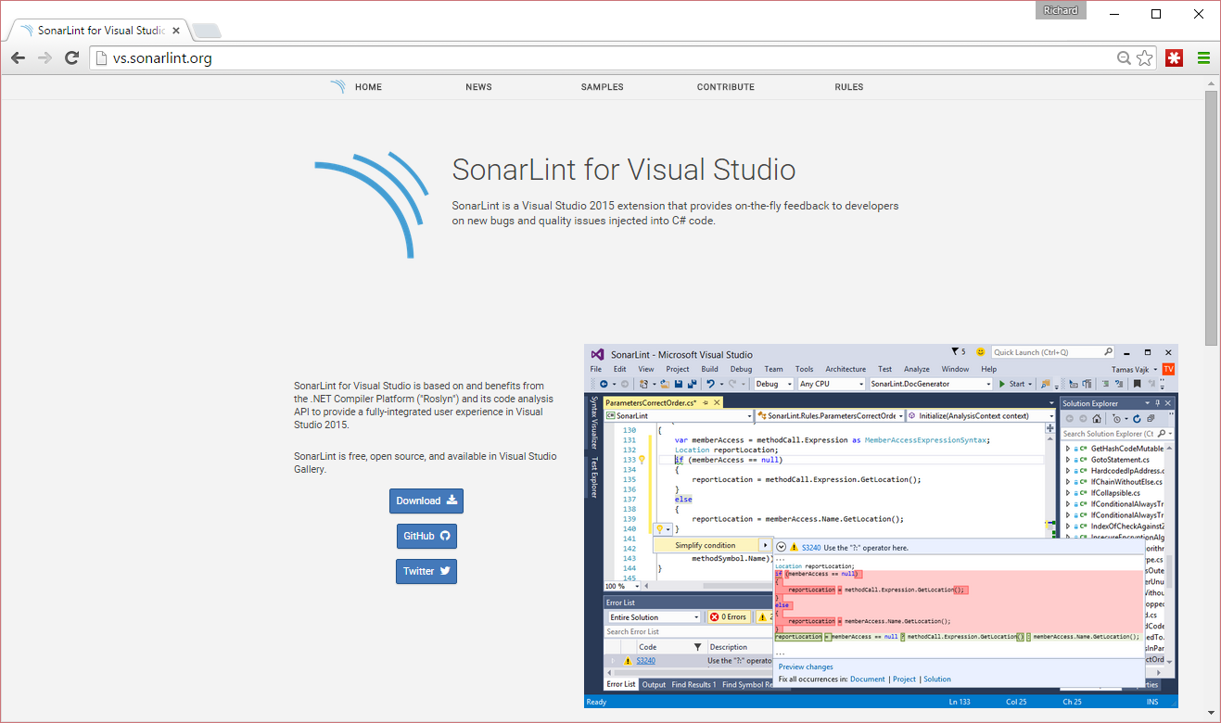

Slide 60
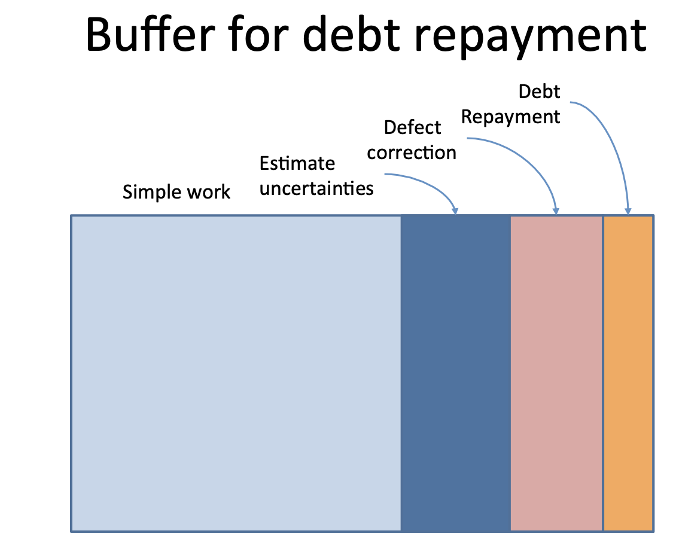

Slide 61
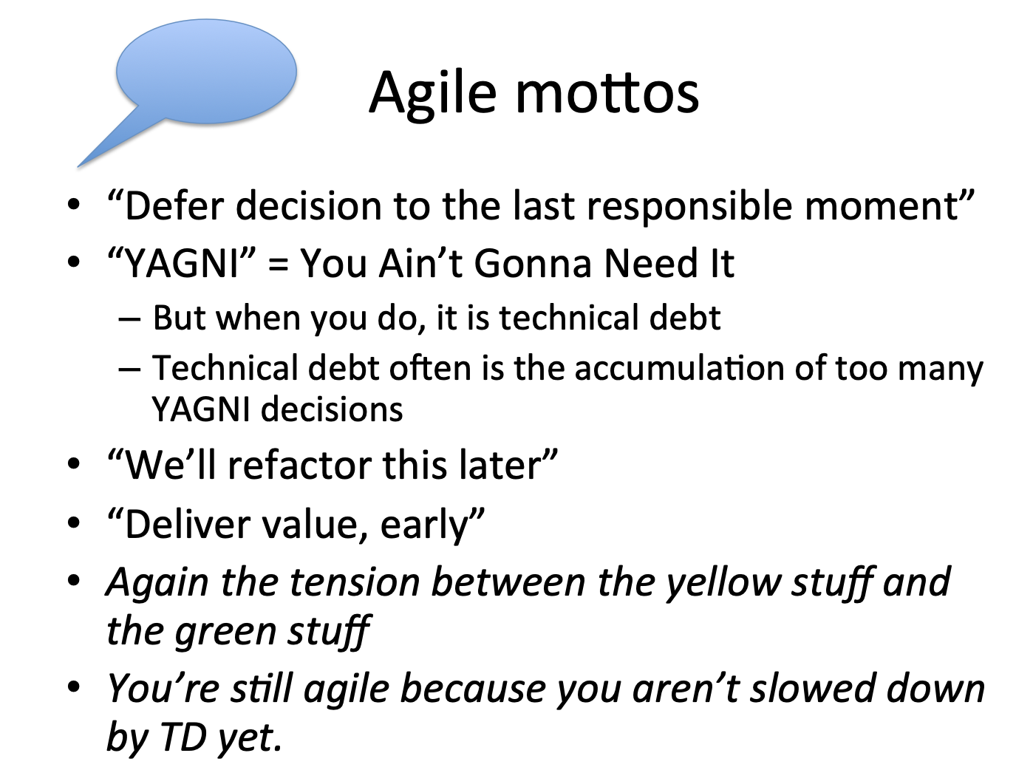

Slide 62
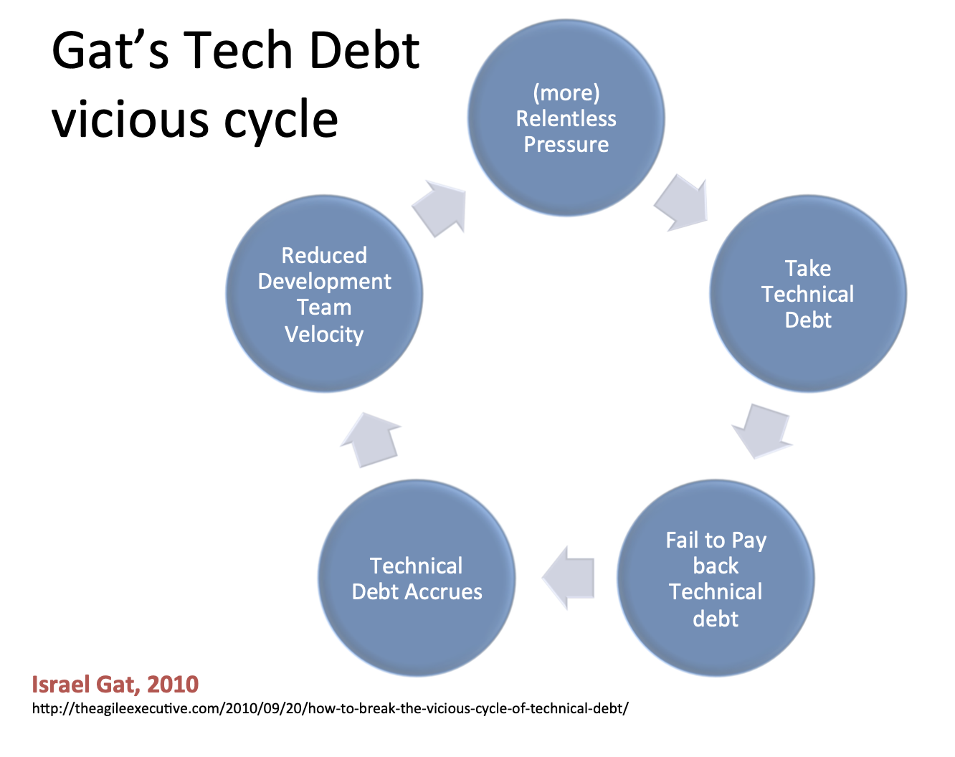

Slide 63
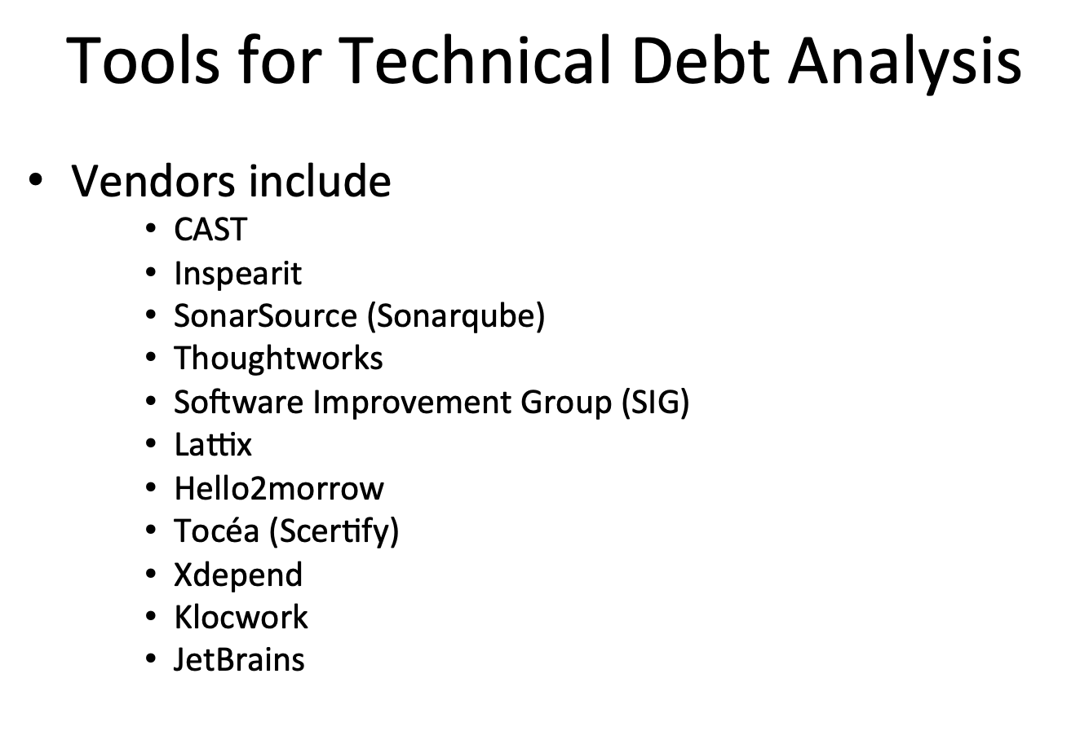

Slide 64
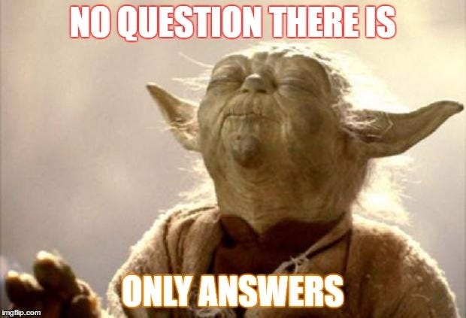
Questions?

Slide 65
Resources
SonarQube
  http://www.sonarqube.org/
Microsoft Product Team on Technical Debt
  http://blogs.msdn.com/b/visualstudioalm/archive/tags/managing+technical+debt/
ALM Rangers Guide on SonarQube
  https://github.com/SonarSource/sonar-.net-documentation
  http://blogs.msdn.com/b/visualstudioalmrangers/archive/tags/vsartechnicaldebt/
SonarLint
  http://vs.sonarlint.org/
Find these slides
  https://github.com/rfennell/Presentations

